Slide 1

Movies recommendation System
ATHARVA SHINDE
03/12/2023

Slide 2


INTRODUCTION
The dataset selected for the recommendation system was the ‘IMDb top 1000’ which was in
CSV format.
This dataset consist of the top most rated
movies with a variety of geographic origin
and vivid Genres making it the most suitable
dataset for movie lover folks.
Moreover, it consists of ratings stated by IMDB
known as ‘International Movie Database System’
which doesn't left any issues in terms of authenticity.
The link for the dataset: https://www.kaggle.com/datasets/harshitshankhdhar/imdb-dataset-of-top-1000-movies-and-tv-shows

Slide 3
Problem statement
In todays hectic world, everyone wants to peacefully transition for some time into an imaginary peaceful world. Cinema i.e. movies is one of the medium for people to disconnect through this materialistic world.
The solution for this problem is to cater the people with a better movie recommendation system. A better movie recommendation system results into increase rate of satisfacation among the audience.
The more satisfied the audience will be the more will be the audience retention resulting into the successful increment of the business.
The recommendation system is a Classification model which comes under the Unsupervised Machine Learning category. So Natural Language Processing NLP based movies recommendation system will be the favorable choice for this problems solution.

Slide 4
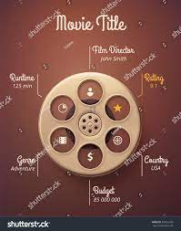
Data overview
Data: 1000 inputs * 15 features
Series Title - Name of the movie
Released Year - Year at which that movie released
Certificate - Certificate earned by that movie
Runtime - Total runtime of the movie
Genre - Genre of the movie
IMDb Rating - Rating of the movie at IMDB site
Overview - mini story/ summary
Meta score - Score earned by the movie
Director - Name of the Director
Star1,Star2,Star3,Star4 - Name of the Stars
No of votes - Total number of votes
Gross - Money earned by that movie

Slide 5
Data preprocessing
Features
Formatting the features
Dropping irrelevant features
Checking correlation of features
Type casting of relevant features
Values
Filling the null values
Dropping duplicate values
Statistical Analysis
Analyzing the duplicate values
Analyzing unique values
 | Runtime | Metascore | Votes | Revenue
count | 1000.000000 | 1000.000000 | 1.000000e+03 | 1.000000e+03
mean | 122.891000 | 77.976000 | 2.736929e+05 | 6.803475e+07
std | 28.093671 | 11.362065 | 3.273727e+05 | 1.000371e+08
min | 45.000000 | 28.000000 | 2.508800e+04 | 1.305000e+03
25% | 103.000000 | 72.000000 | 5.552625e+04 | 5.012919e+06
50% | 119.000000 | 78.000000 | 1.385485e+05 | 4.238945e+07
75% | 137.000000 | 85.250000 | 3.741612e+05 | 6.803475e+07
max | 321.000000 | 100.000000 | 2.343110e+06 | 9.366622e+08

Slide 6
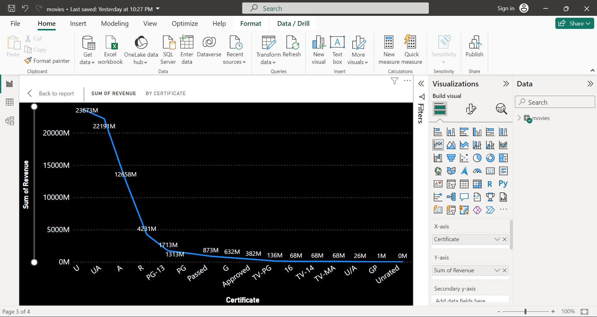
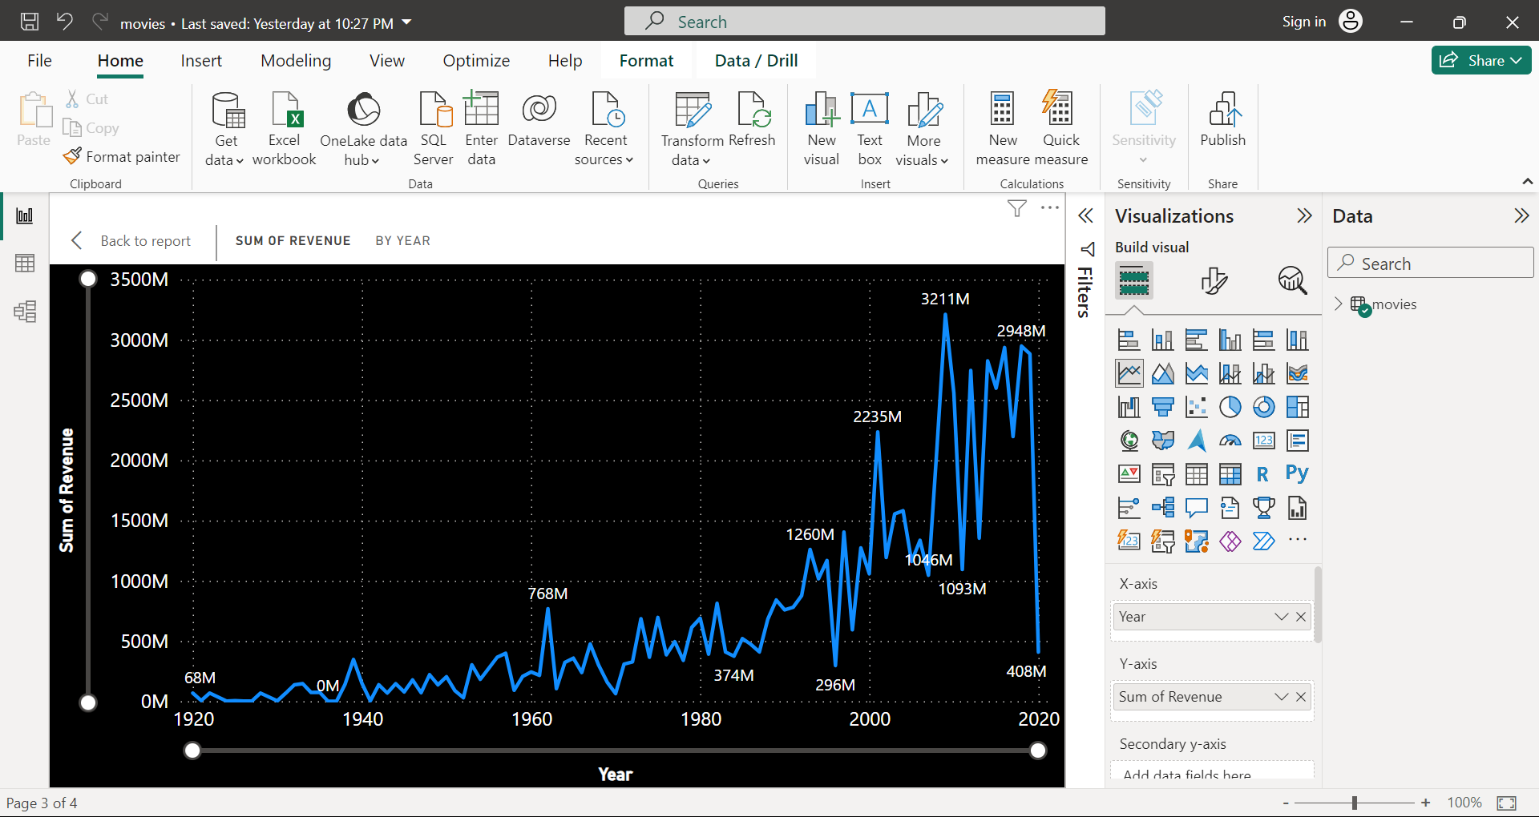
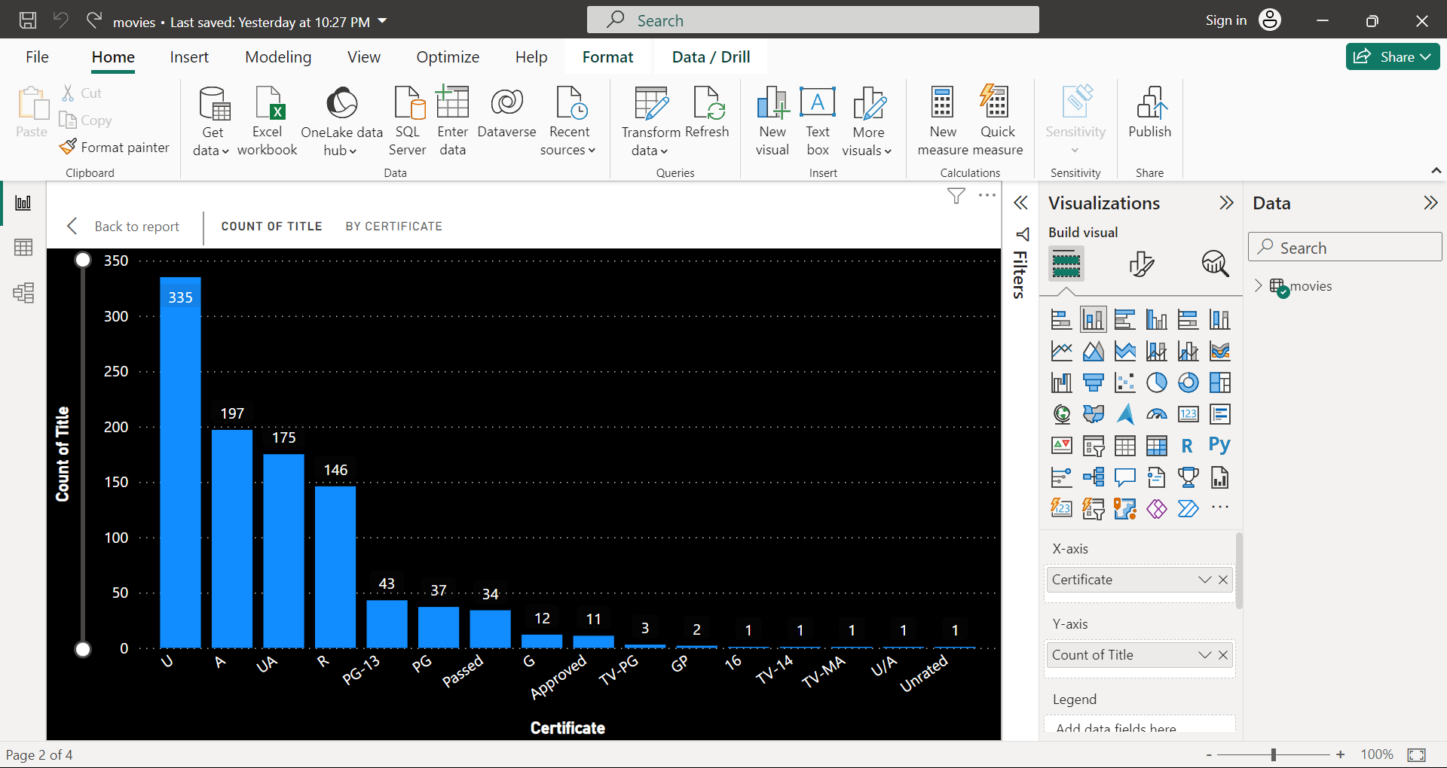
The ‘U’ Certificate is associated with high title count followed by ‘UA’ and ‘A’ certificate also it contributes maximum in the Revenue generated by the movies
There is a significant increase in Revenue during the time span of early 2000’s.

Slide 7
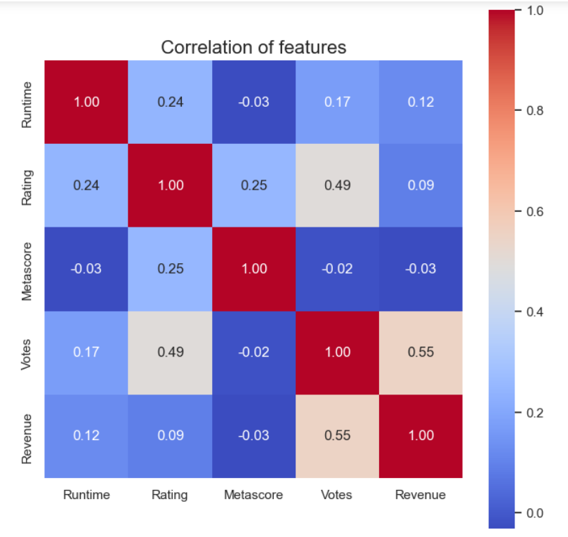
Feature selection and engineering
The features in the dataset are almost have low and a medium correlation between them.
Feature ‘Votes’ have a medium level of correlation with ‘Rating’ and ‘Revenue’ of the movie
As we intend to build a recommendation system which is a category of Unsupervised Machine Learning , Classification Algorithm we use ‘TFIDF Vectorizer’ method.
Importing the TFIDF Vectorizer function, fitting and transforming the Features ‘Plot’, ‘Genre’, ‘Director’ to create a TFIDF matrix.

Slide 8
Data splitting
tf = TfidfVectorizer(min_df=3, max_features=None,
strip_accents='unicode', analyzer = 'word’,token_pattern = r'\w{1,}',
ngram_range=(1,3),
stop_words='english’)
Creating a TFIDF vector matrix and then feeding it into the sigmoid kernel for model preparation.
tfidf_matrix = tf.fit_transform(movies['Plot’])
from sklearn.metrics.pairwise import sigmoid_kernel
sig = sigmoid_kernel(tfidf_matrix, tfidf_matrix)

Slide 9
Model selection
The aim is to build a movies recommendation system model which is a Classification task .
So the appropriate model to implement was an NLP: Natural Language Processing Model.
The reason to select this model was we were building a system on the language input from the dataset. So to understand the input and give an output in language format NLP algorithms are the favorable choices
from sklearn.feature_extraction.text import TfidfVectorizer
TfidfVectorizer(min_df=3, ngram_range=(1, 3), stop_words='english',
strip_accents='unicode', token_pattern='\\w{1,}')

Slide 10
Model training and evaluation
The model training process initiates with the transform of the input feature and creating a TFIDF matrix.
Further this matrix is transformed into sigmoid kernel and then dropping the duplicate values of the Title thereby sorting the enumerated list of the features.
tfidf_matrix = tf.fit_transform(movies['Plot’])
from sklearn.metrics.pairwise import sigmoid_kernel
sig = sigmoid_kernel(tfidf_matrix, tfidf_matrix)
sorted(list(enumerate(sig[indices['The Godfather']])), key=lambda x : x[1], reverse=True)

Slide 11
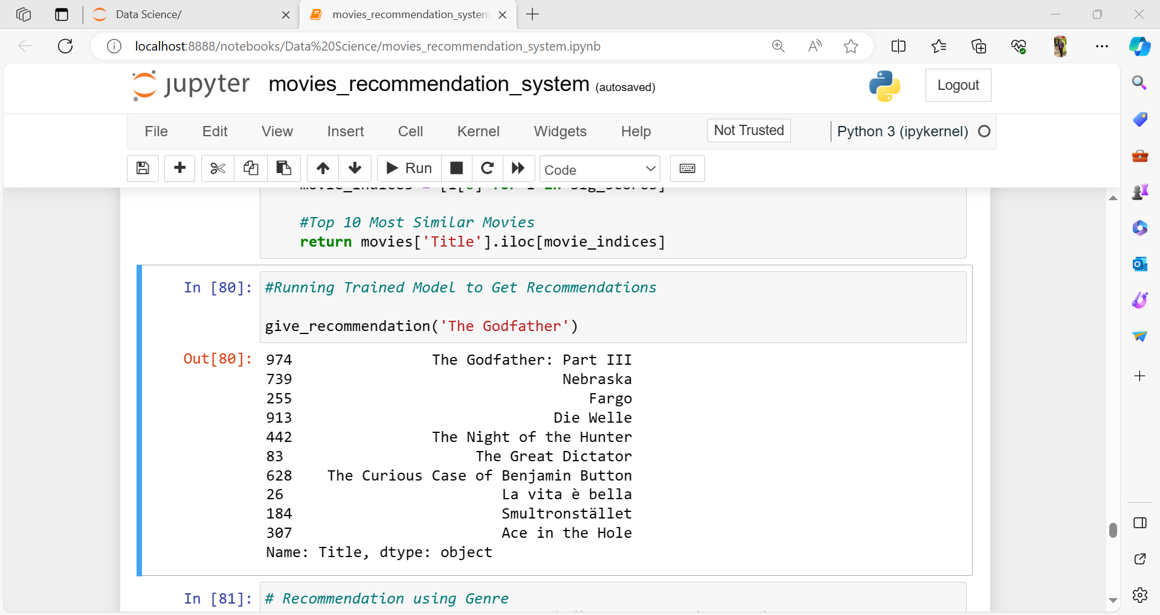
Result and analysis
The model is successfully trained and interpreted the results.
give_recommendation('The Godfather’)
The model generates the recommended
movies based on the Title input provided
with Plot being the parameter of the function.
Parameters like Genre, Director also generated
the movies suggestions.

Slide 12
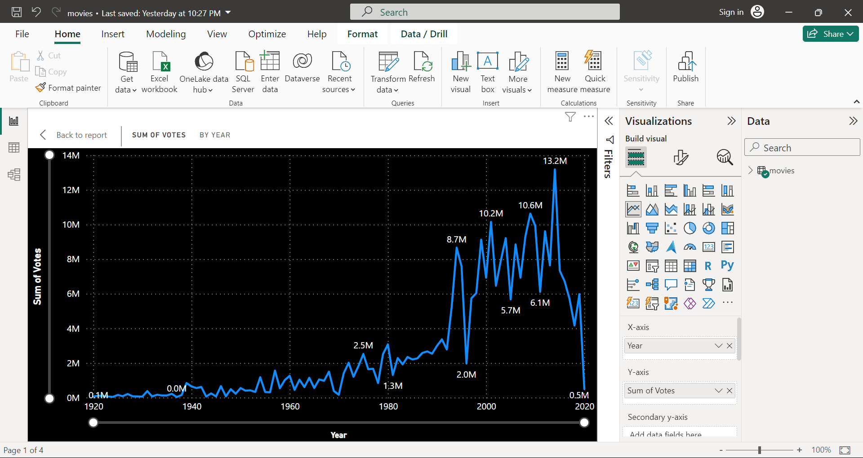
 | Genre | Rating
1 | Animation, Drama, War | 8.50
2 | Drama, Musical | 8.40
3 | Action, Sci-Fi | 8.40
4 | Drama, Mystery, War | 8.35
5 | Western | 8.35
6 | Crime, Drama, Music | 8.30
7 | Mystery, Romance, Thriller | 8.30
8 | Adventure, Mystery, Thriller | 8.30
9 | Drama, Fantasy, Horror | 8.30
10 | Comedy, Musical, Romance | 8.30
 | Genre | Metascore
1 | Mystery, Romance, Thriller | 100.0
2 | Comedy, Musical, Romance | 99.0
3 | Drama, Fantasy, War | 98.0
4 | Adventure, Mystery, Thriller | 98.0
5 | Comedy, Music, Romance | 98.0
6 | Action, Adventure, Romance | 97.0
7 | Film-Noir, Mystery, Thriller | 97.0
8 | Film-Noir, Mystery | 96.0
9 | Film-Noir, Thriller | 94.0
10 | Animation, Drama, War | 94.0

Slide 13
conclusion
Most movies are 'U' certified suitable for all ages.
TV-14 certificate has the highest rating.
Movies with 'Animation,Drama,War' genre received most rating.
Movies whose genre 'Mystery, Romance, Thriller' achieved higher meta score.
Movies whose genre 'Action, Adventure, Sci-Fi' achieve the most earnings.
Movies whose certificates 'UA' achieved more earnings.
There is strong relation between Runtime and the rating of movie.
Approximately the higher meta score movie gain the higher earnings.
There's a week positive relationship between IMDB rating and earnings of the movie.

Slide 14
Future steps
The current model is good in terms of recommending the similar movies in terms of Plot, Genres, Directors.
The further additional improvement can be achieved by developing a versatile and robust model like recommending :
movies based on Cast
movies based on Rating
movies based on Certificates
movies based on Released Year
movies based Revenue
movies based on Runtime
Finally implementing some front-end deployment of the model with some web application and pleasing UI/UX visuals.

Slide 15
references
The primary references include:
Kaggle website for dataset and EDA
GPT model for data analysis
Study material
Google search
YouTube for some additional concepts.

Slide 16
Contact information
Name : Atharva Shinde
Email ID : atharva.shinde@gmail.com
Contact no. : +91 9137391904

